Slide 1
Job orchestration using Airflow
Abdulmajeed

Slide 2
Agenda
Orchestration
Airflow
Examples

Slide 3
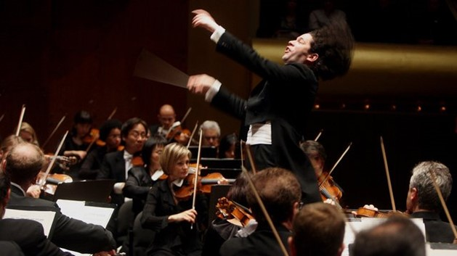
Jobs Orchestration
When you have jobs/steps running in different tools or servers and must be run in a sequence. There must be an external system that can control the steps, failures and retries across all different tools and makes sure that the steps are executed in the right order.

Slide 4
Directed Acyclic Graph (DAG)
“A directed acyclic graph (DAG) is a conceptual representation of a series of activities. The order of the activities is depicted by a graph, which is visually presented as a set of circles, each one representing an activity, some of which are connected by lines, which represent the flow from one activity to another.”
Extract Data from API
Process and Load Into
DWH
Update Dims
Update Fact Tables
Refresh BI data sources

Slide 5
Idempotency
Is the property of certain operations in mathematics and computer science whereby they can be applied multiple times without changing the result beyond the initial application. In other words, if you have a function, you can run it N number of times and you’ll always get the desired result.
Extract Data from API
Process and Load Into
DWH
Update Dims
Update Fact Tables
Refresh BI data sources

Slide 6
Scheduling
You can schedule jobs using special tools or operation system utilities, such as Windows Scheduler in Windows or Cron in Linux.

Slide 7



Jobs Orchestration Tools.

Slide 8
Airflow

Slide 9
Airflow Definition
Apache Airflow™ is an open-source platform for developing, scheduling, and monitoring batch-oriented workflows. Airflow’s extensible Python framework enables you to build workflows connecting with virtually any technology. A web interface helps manage the state of your workflows. Airflow is deployable in many ways, varying from a single process on your laptop to a distributed setup to support even the biggest workflows.

Slide 10
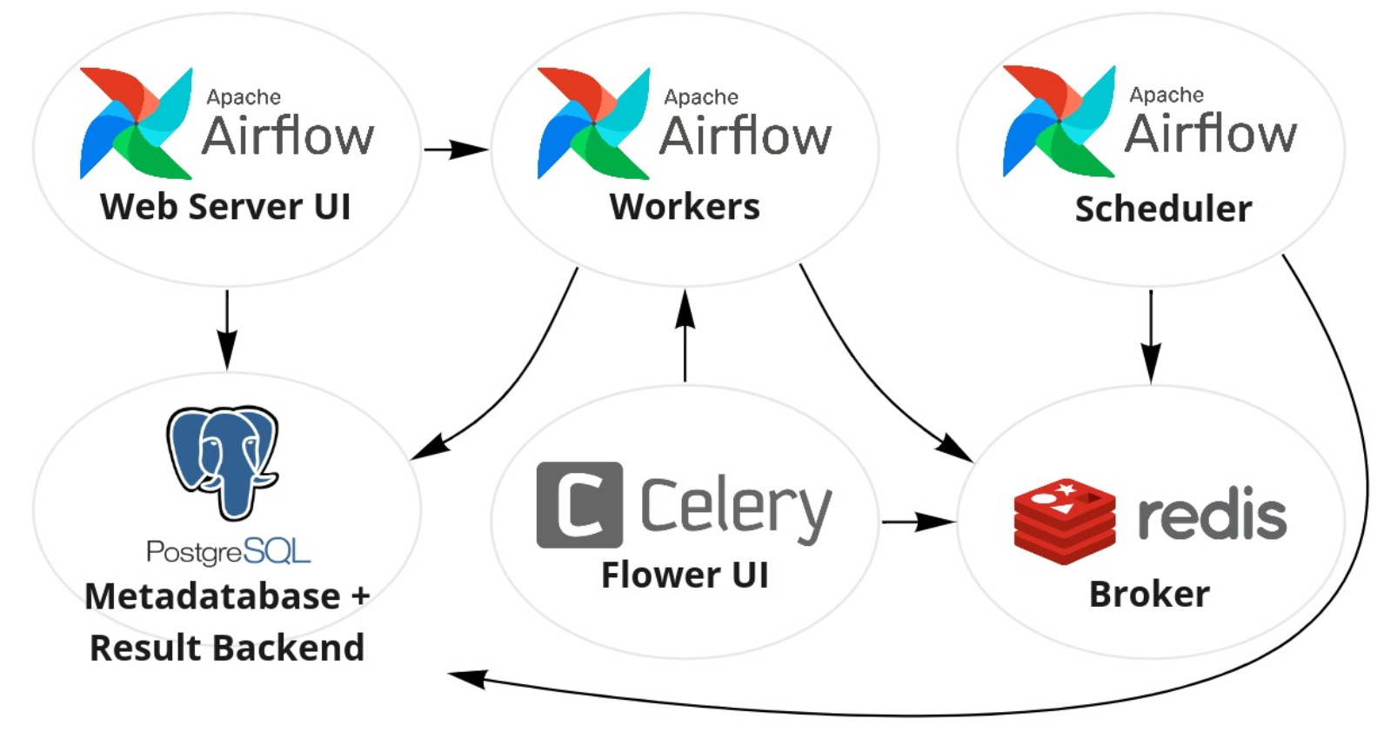
Airflow Architecture

Slide 11
Workload Types
Operators
Sensors
Decorated Task
Predefined tasks that you can string together quickly to build most parts of your dags.
A special subclass of operators which are entirely about waiting for an external event to happen.
A custom Python function packaged up as a Task

Slide 12
Examples

Slide 13


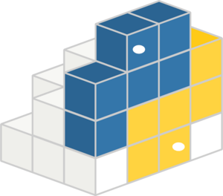
Ways To Run Airflow

Slide 14
Running Airflow Using Docker
https://airflow.apache.org/docs/apache-airflow/stable/howto/docker-compose/index.html#running-airflow

Slide 15
Examples

Slide 16
Thank You

